Slide 1
MGMT 6055 Project Scope & requirements
Lawrence Kinlin School of Business
Module 9
Notes:
Content for slides in this PPT file is drawn significantly from PMBOK, 6th edition, published by PMI (required text for this course)

Slide 2
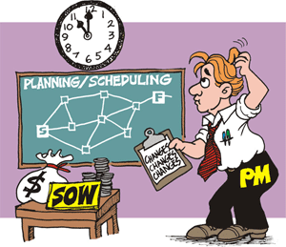

Slide 3
Learning Objectives
Create WBS
The Project Baseline
Schedule, cost, and scope baselines

Slide 4

Create Work Breakdown Structure

Slide 5
Create Work Breakdown Structure (WBS)
Subdividing project deliverables into smaller, more manageable components
Deliverable-oriented hierarchical decomposition of the work
Defines the total work of the project

Slide 6
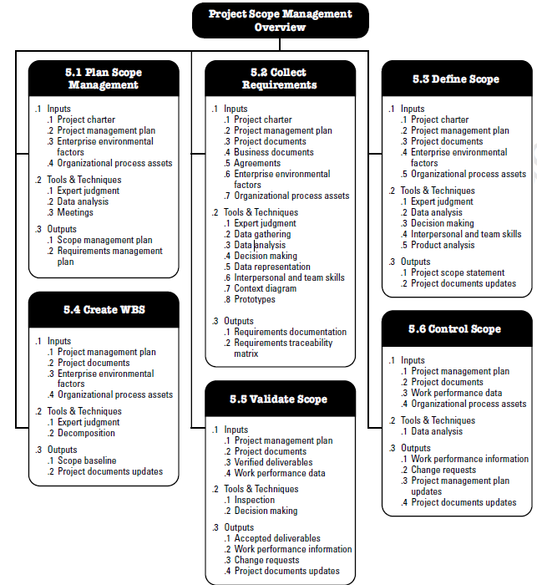
Source: PMBOK (6th ed), pg. 130

Slide 7
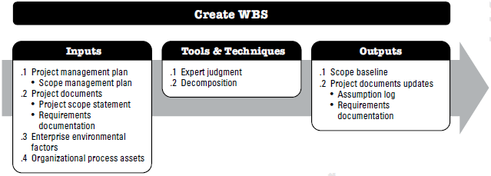
Create WBS
Notes:
Source: PMBOK 6th ed. (PMI), p. 156

Slide 8
Create WBS - Inputs
Project Management Plan
Scope Management Plan (how to create the WBS, how it will be maintained/ approved)
Project documents
Scope statement (what’s in/ what’s out)
Requirements documentation (what needs to be produced)
Enterprise environmental factors
E.g., industry-specific WBS standards (such as ISO/IEC 15288 on Systems Engineering – System Life Cycle Processes)
Organizational process assets
E.g., previous project files and lessons learned
This link is FYI – you won’t be tested on the contents of this web site!

Slide 9
Create WBS - Tools and Techniques
Expert judgement
Individuals who have technical expertise or previous experience with similar projects
Different approaches may be used
Using pre-existing organizational templates
Top-down approach for creating WBS
Bottom-up approach when integrating sub-components

Slide 10
Create WBS - Tools and Techniques (cont’d)
Decomposition
Breaking the scope and deliverables into a hierarchy of increasingly smaller chunks of work
Assigning identification codes (WBS codes) to each component at each level
Lowest level of the WBS (smallest unit of work) consist of work packages
Work package: the lowest level of the WBS for which cost and duration can be estimated and managed

Slide 11
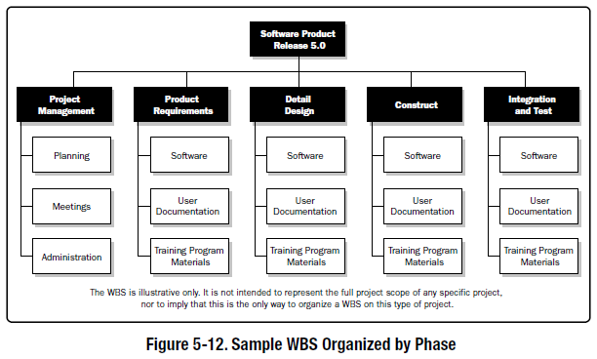
WBS Organized by Project Phase
Notes:
Source: PMBOK 6th ed. (PMI), Figure 5-13, pg. 159

Slide 12
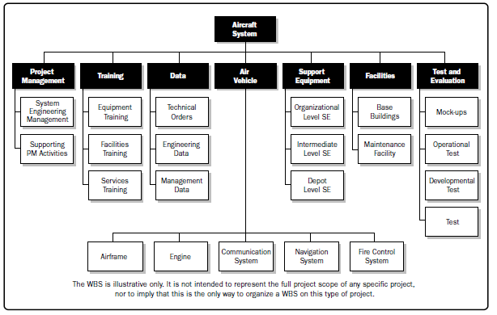
WBS Organized by Major Deliverables
Notes:
Source: PMBOK 6th ed. (PMI), Figure 5-14, p. 160

Slide 13
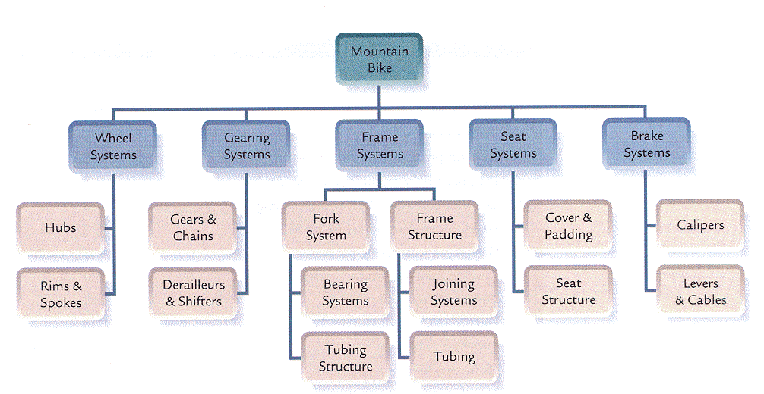
WBS Example
NOT complete! We need to add a branch for “Project Management” deliverables! (PMBOK)

Slide 14
Tips and Guidelines for Creating the WBS
If you decompose too much, it is inefficient to manage
All of the work packages, combined, make up the entire scope of the project (the “100 percent rule”)
WBS structures consist of deliverables, NOT TASKS OR ACTIVITIES (use nouns, not verbs)
WBS should also include project management work

Slide 15

Tips and Guidelines for Creating the WBS
Rolling wave planning: You might not have enough information to decompose some deliverables at the start of the project – some decomposition may be undertaken as the project goes along and information becomes known.
Planning packages are WBS components that haven’t been decomposed to work packages yet (because of a lack of detailed information).
Notes:
Image Source: https://www.google.com/url?sa=i&rct=j&q=&esrc=s&source=images&cd=&cad=rja&uact=8&ved=2ahUKEwiyoLDnhLbaAhWI1IMKHXb4D2oQjRx6BAgAEAU&url=https%3A%2F%2Fwww.pinterest.com%2Fpin%2F71635450295859250%2F&psig=AOvVaw3FV8NWt-OoJNHdXyWQLqm8&ust=1523667195176030
Link for example of planning packages: https://tensix.com/2014/03/some-guidelines-regarding-planning-packages/
Another link: https://www.izenbridge.com/blog/what-are-the-differences-between-work-package-and-planning-package/

Slide 16


Don’t be tempted to create the WBS as an activity-oriented structure
Activities will be defined in the “Project Time Management” processes (Define Activities, Sequence Activities, Estimate Activity Resources, etc.)… using the WBS as a basis
Notes:
http://project-pro.us/2010/07/12/benefits-of-a-deliverables-based-wbs/
http://www.pm-primer.com/pmbok-define-activities
http://www.rationalplan.com/projectmanagementblog/work-breakdown-structure-made-easy/
http://pmworldjournal.net/wp-content/uploads/2013/01/pmwj7-feb2013-dash-pmbok-guide-5th-edition-msproject2010-featured-paper.pdf

Slide 17



If you’ve used Microsoft Project software before, you might be confused about the WBS we’ve learned here and the list of Tasks that you create in MS Project. How does the PMBOK WBS relate to MS Project? A Work Package in PMBOK can be considered equivalent to a Summary Task in MS Project.
Notes:
http://project-pro.us/2010/07/12/benefits-of-a-deliverables-based-wbs/
http://www.pm-primer.com/pmbok-define-activities
http://www.rationalplan.com/projectmanagementblog/work-breakdown-structure-made-easy/
http://pmworldjournal.net/wp-content/uploads/2013/01/pmwj7-feb2013-dash-pmbok-guide-5th-edition-msproject2010-featured-paper.pdf [re: PMBOK vs MS Project WBS]

Slide 18
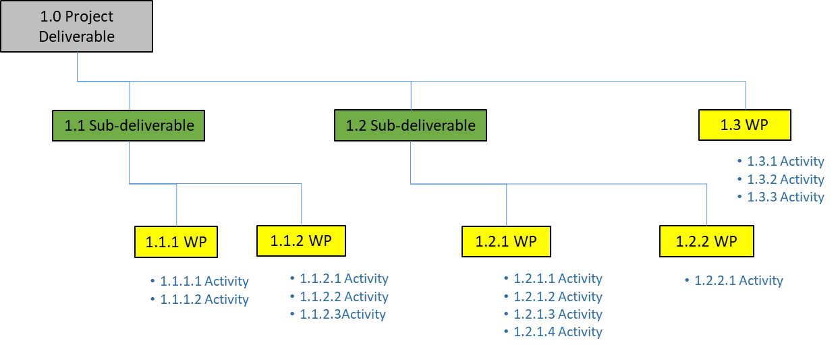
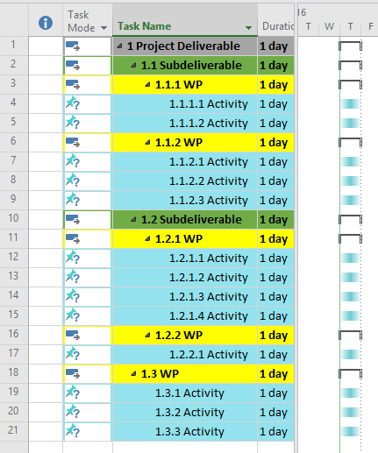
Hierarchical WBS with Activities - Comparison in MS Project
Notes:
Source: Professor D. Hemington
WBS tells us WHAT we’re producing, while activities tell us HOW we’re going to produce it
Some organizations use activities in the WBS… .BUT…. For PMBOK purposes (and the certification exams), the WBS is deliverable-oriented. Activities aren’t included in the WBS structure.
In MS Project, activities are assigned a WBS Code to indicate which WBS work package they are associated with.
Source: https://www.pmbypm.com/what-is-the-difference-between-work-package-and-activity/

Slide 19
Control Account (CA)
A CA is a management control point – scope, budget, cost and schedule data are measured and tracked
Each work package is assigned to a control account
More than one work package can belong to a CA (but a work package cannot belong to two or more CAs)
CAs may be placed at different points on the WBS (e.g., at the top of each branch system in the WBS)

Slide 20
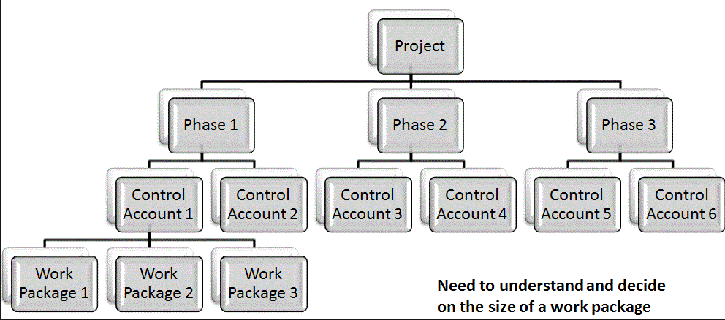
Control Account (CA)
Notes:
https://www.google.ca/search?q=wbs+control+account&source=lnms&tbm=isch&sa=X&ved=0CAcQ_AUoAWoVChMIl4HKjJf3yAIVV8FjCh2a_Am5&biw=1680&bih=953#imgrc=H_BuToWkWoyvlM%3A

Slide 21
WBS Dictionary
A document that provides detailed deliverable, activity, and scheduling information for each component in the WBS
WBS Dictionary may include the following details:
WBS Code identifier
Description of work
Assumptions/constraints
Responsible organization
Schedule milestones
Resources required
Cost estimates
Quality requirements
Acceptance criteria

Slide 22
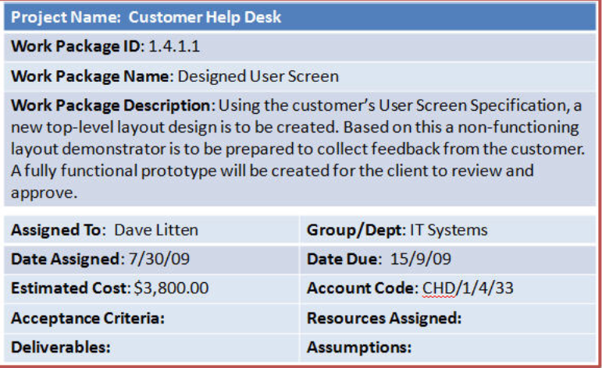
Sample WBS Dictionary Entry
Notes:
Source: http://www.pm-primer.com/the-pmbok-create-wbs

Slide 23
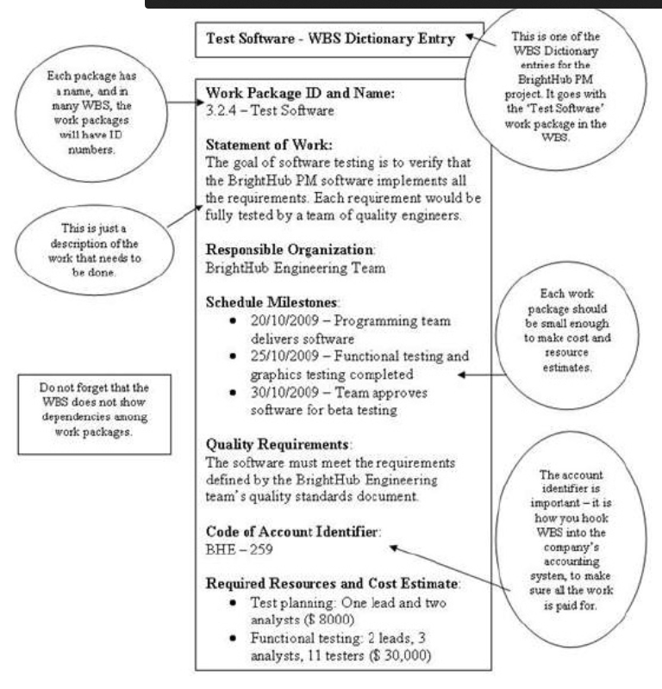
Another Sample WBS Dictionary Entry
Notes:
http://www.slideshare.net/ejlp12/pmp-training-05-project-scope-management

Slide 24
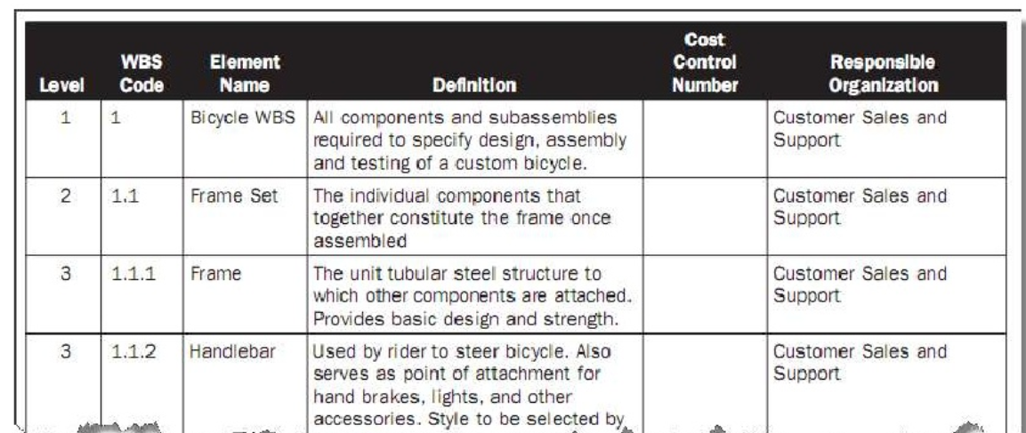
Another Sample WBS Dictionary Entry
Notes:
http://www.slideshare.net/ejlp12/pmp-training-05-project-scope-management

Slide 25
Create WBS - Outputs
Scope baseline
Scope statement
WBS
WBS dictionary
Project documents updates
E.g., creating the WBS may lead to changes in requirements documentation
Notes:
Note: In PMBOK 6th edition, the scope baseline components are expanded to include work packages and planning packages (I’m excluding them in this PPT slide for clarity – work packages and planning packages are components of WBS structures, so I don’t want students to think of them as distinctly separate from the WBS)

Slide 26
Project Baseline
An approved plan for a project, plus or minus approved changes
It is compared to actual performance to determine if performance is within acceptable variance thresholds
Consists of schedule, cost performance and scope baseline
A snapshot of the project on day zero

